Slide 1

LipReaderAI Advanced Multi-Speaker Lipreading for Enhanced Communication Accessibility
Predicting Speech using Lip Reading by Machine Learning Model
PHYS 594: Introduction to Machine Learning
Rohan Nain and Shivam

Slide 2
Introduction
ROADMAP
Introduction
Machine
Learning
Speech Recognition Tech
Overview: LipReaderAI
Project Objective
Overview: LipReaderAI
Importance
Project Objective
ML Framework
Data Set
DNN Architecture
Training the Model
Results

Slide 3
ROADMAP
Introduction
Machine
Learning
Speech Recognition Tech
Overview: LipReaderAI
Project Objective
ML Framework
Data Set
DNN Architecture
Training the Model
Results

Slide 4
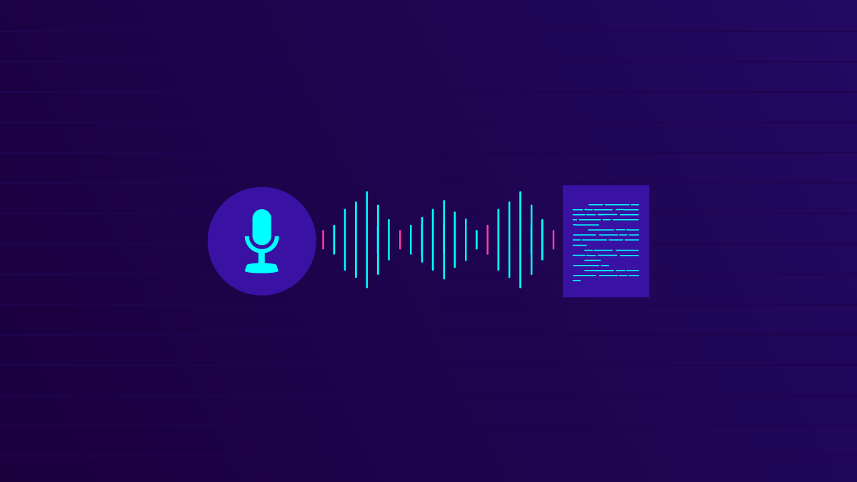
Speech Recognition Tech
Traditional Methods:
Traditionally these methods relied on audio signals to convert spoken words to text.
Limitations:
Struggles in noisy or loud environments.
Ineffective when the audio signal is unclear or absent.
Need for Visual Recognition:
Study the lip movements to complement or replace audio signals.
Enhances accuracy in adverse conditions where audio-based methods fail.

Slide 5
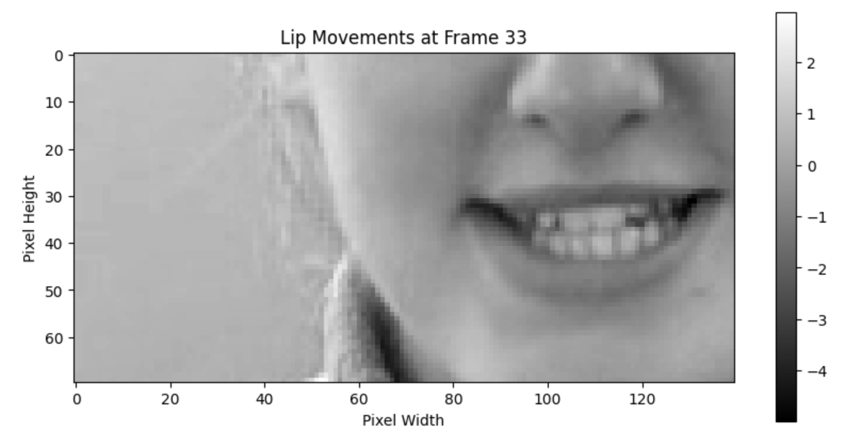


LipReaderAI
Purpose: Develop an advanced lipreading model for better communication.
Motivation: Help individuals with hearing impairments and improve noisy environment speech recognition.
Implementation: Built with TensorFlow and OpenCV.

Slide 7
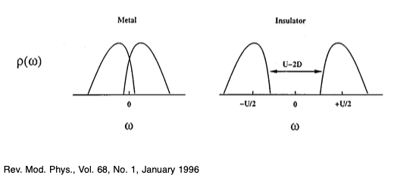
Project Objective
Develop a lipreading ML model and test it on a custom dataset.
Calculate the average similarity score on the Custom Dataset of one speaker with 1001 videos.

Slide 8
Machine Learning Framework
Data
DNN
Training
Validation
DNN
Training
Validation

Slide 9
Data
DNN
Training
Validation
Trained on 10 speakers, each with 1001 videos, from the GRID dataset
Model Architecture:
3D Convolutional layers followed by Bidirectional LSTM layers and a Dense output layer with CTC loss.
Training the model with the appropriate Loss function.
Testing the Model on two different custom Speakers.

Slide 10
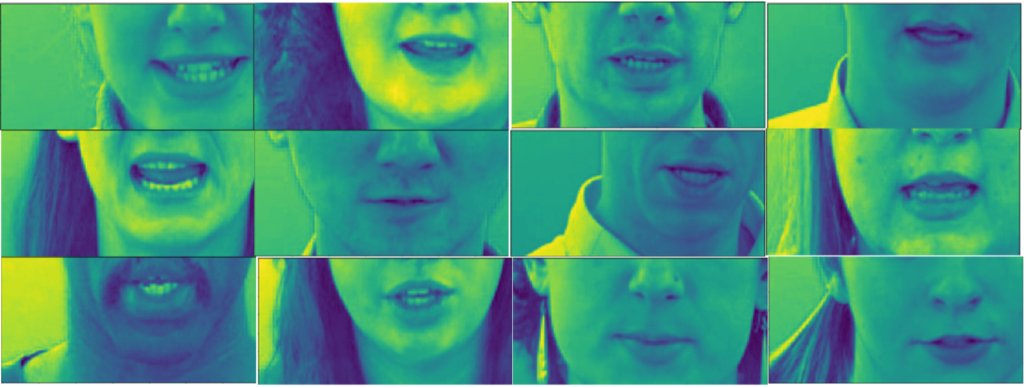
Data Generation
Data
Validation
Training
DNN
We trained our model using a subset of the GRID audiovisual sentence corpus. Specifically, we selected videos from 10 different speakers, with each speaker contributing 1001 videos, resulting in a total of 10010 videos. This dataset provides a diverse and comprehensive set of lip movements to train our model effectively.
Trained on 10 speakers, each with 1001 videos, from the GRID dataset

Slide 11
Data
DNN
Training
Validation
Trained on 10 speakers, each with 1001 videos, from the GRID dataset
Deep Neural Network Architecture for Model training.
Training the model with the appropriate Loss function.
Testing the Model on two different custom Speakers.

Slide 12
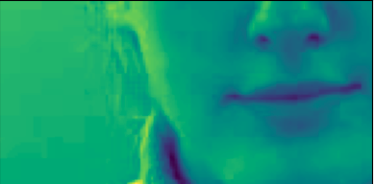
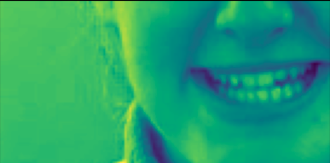
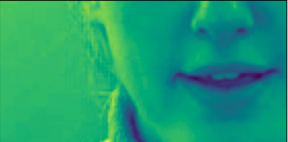
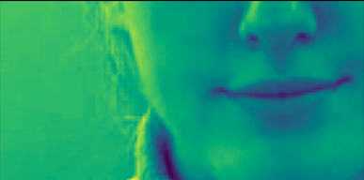
Deep Neural Network Architecture
Data
Validation
Training
DNN
Model Architecture:
3D Convolutional layers followed by Bidirectional LSTM layers and a Dense output layer with CTC loss.
We need the dataset to train the DNN.
Features
Labels
Deep Neural Network Architecture for Model training.
Time
3D
Convolutions
ReLU Activation
Pooling (1,2,2)
3 Sequential Layers (128, 256, 75)
2x - Bi-Directional LSTM
Dropout (0.5)
Softmax Activation
CTC Loss
Input data (75 frames)

Slide 13
Data
DNN
Training
Validation
We need the dataset to train the DNN.
Features
Labels
Deep Neural Network Architecture for Model training.
Hyperparameters and Training Losses
Testing the Model on two different custom Speakers.

Slide 14
Hyperparameters
Hyperparameters | Values
Checkpoint Directory | Saved_LipNet_model_5_speakers/checkpoints
Checkpoint monitor | loss
Save Weights Only | True
Save Best Only | True
Verbose Output | 1
Latest Checkpoint | Loaded if exists
Epochs | 30
Callbacks | Checkpoint_callback, schedule_callback
Optimizer | Adam
Learning Rate | 0.0001
Loss Function | CTCLoss
Learning Rate Schedule | Exponential decay after epoch 15
Data
DNN
Training
Validation
We need the dataset to train the DNN.
Features
Labels
Training the model with the appropriate Loss function.
Deep Neural Network Architecture for Model training.

Slide 15
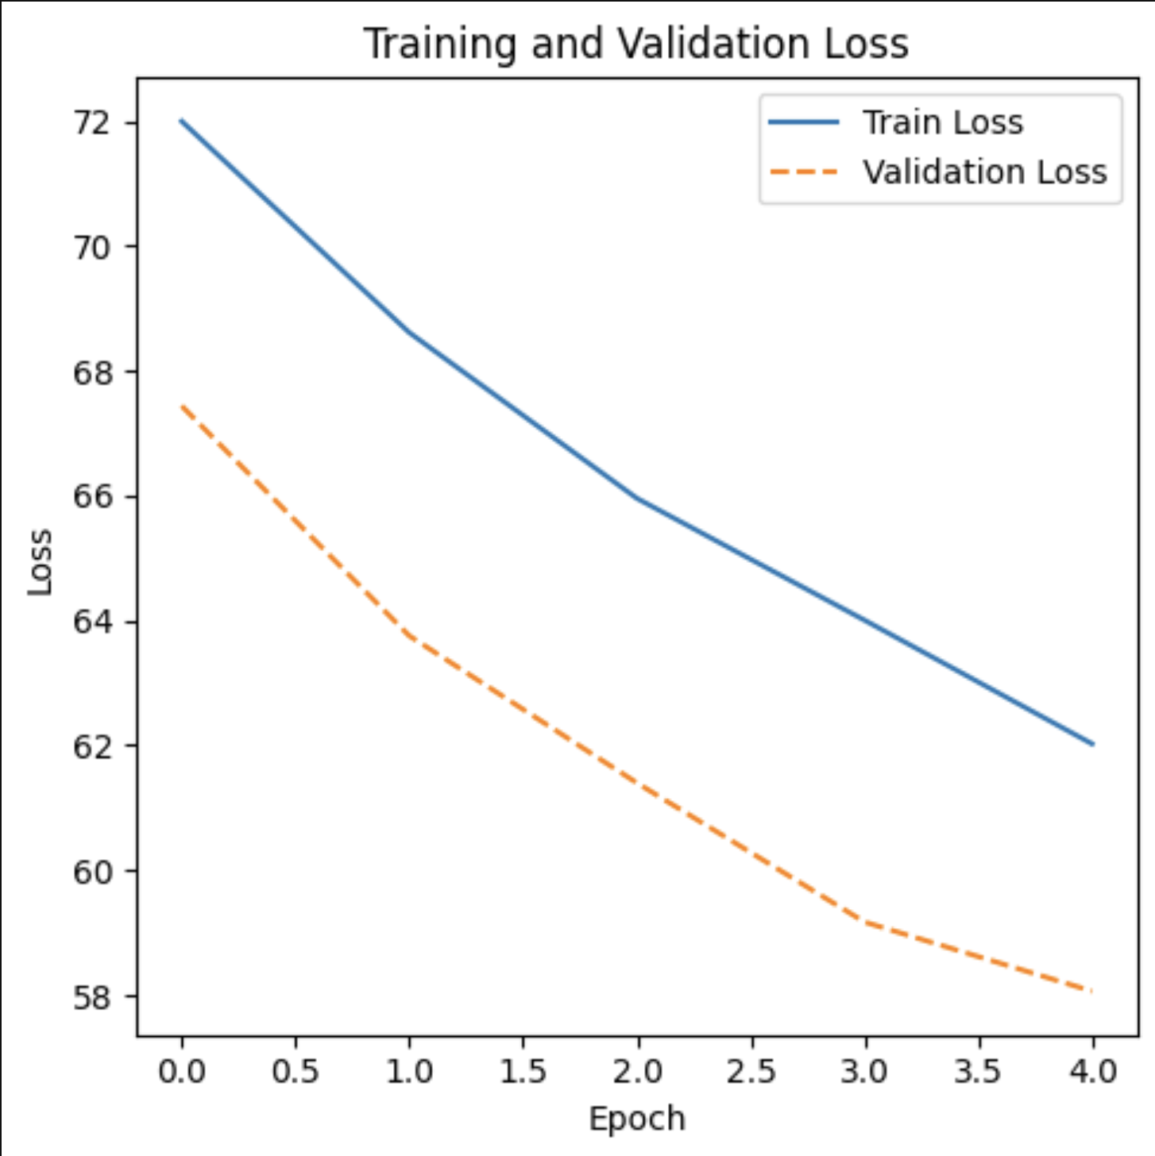
Training Losses
Data
DNN
Training
Validation
We need the dataset to train the DNN.
Features
Labels
Training the model with the appropriate Loss function.
Deep Neural Network Architecture for Model training.

Slide 16
Data
DNN
Training
Validation
We need the dataset to train the DNN.
Features
Labels
Deep Neural Network Architecture for Model training.
Training the model with the appropriate Loss function.
Testing the Model on two different custom Speakers.

Slide 17
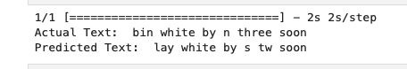
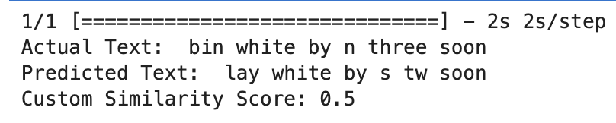
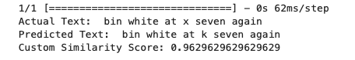
Validation on Custom Dataset
DNN
Data
Training
Validation
Training the model with the appropriate Loss function.
We need the dataset to train the DNN.
Features
Labels
Testing the Model on two different custom Speakers.
Deep Neural Network Architecture for Model training.
Bin white by n three soon
Bin white at x seven again

Slide 18
Code and Live Demonstration
DNN
Data
Training
Training the model with the appropriate Loss function.
We need the dataset to train the DNN.
Features
Labels
Deep Neural Network Architecture for Model training.
Rohan will be presenting that.

Slide 19
Concluding Thoughts
With bigger and more diverse datasets, the model can be further trained to increase accuracy.
With more data, lipreading technology can also be extended to various languages!
Can also be implemented for real time lip reading.

Slide 20
References
Assael, Y., et al. "LipNet: End-to-End Sentence-level Lipreading." 2016
Ting, Y., et al. "Comprehensive Review on Lip Reading Techniques." 2022
Son, J., et al. "Lip Reading: A New Leap in Speech Recognition." 2017
Pu, Y., et al. "Review on Automatic Lip-Reading in the Wild." 2023
Gutierrez, O., et al. "Lip Reading and Recognition for Improved Speech Systems." 2017
Mestri, S., et al. "Analysis of Lip Movement for Speech Recognition and its Applications." 2019
ChatGPT
Owens, E., et al. "Visually-Aided Speech Enhancement." 2016
Exarchos, M., et al. "Deep Learning Models for Lip-Reading." 2024
Lu, D., et al. "Automatic Lip Reading Based on Spatial-Temporal Visual Analysis." 2019
Kastaniotis, I., et al. "Lip Reading Through Deep Learning: A Review." 2020

